Slide 1



Development of a Smoothed Particle Hydrodynamics with Gravity code for astrophysics
Sasha Safonova
Arizona Space Grant Symposium, April 2017

Slide 2
Outline
What is SPH?
What does our code do?
Testing the code
Visualizing the code’s output
Applications and future steps

Slide 3
What is SPH?
Smoothed Particle Hydrodynamics

Slide 4
Smoothed Particle Hydrodynamics
Computational method
Simulates fluid dynamics
Mesh free: tracks individual particles
Applications in astrophysics, fluid simulations, computer graphics and other astonishingly diverse fields
Almost always when you see blood, water or smoke in a video game, it’s SPH

Slide 5

Imagine that you have been hired by Pixar.
Your task is to write computer graphics code that makes beautiful ocean waves.
Code
+
Hydrodynamics
Image source: https://media.giphy.com/media/UEgZEuvWJJCTK/source.gif

Slide 6
You model the ocean as a collection of small volumes of water, “particles”.

Slide 7
Each particle experiences a cumulative force from all others.
In SPH, the force can include hydrodynamic interactions, gravity, and other terms.

Slide 8
The force experienced by each particle lets us model fluid dynamics.
Find positions and velocities
Calculate each particle’s acceleration
Find new positions and velocities
ma_{i} = Σ F_{ij}
^{j}

Slide 9
SPH relies on Lagrangian hydrodynamics.
SPH density is the number of points per volume and is calculated at each time step.
Eulerian
coordinates
Lagrangian coordinates
v₁
ρ₁
r_{i}
r_{j}
ρ
v₂
r₁₂
r_{k}
v₃
ρ₂
ρ₃

Slide 10
What does our code do?
Smoothed Particle Hydrodynamics

Slide 11
Compressible SPH + Gravity
Our code is written for astrophysics applications and accommodates:
Compressible fluids
Gravity
Artificial viscosity to handle shocks
SPH lacks intrinsic numerical viscosity
An innovative tree code shifts complexity from O(N²) to O(N log N)

Slide 12
Speeding up the code: Neighbor search
We search for each particle’s “neighbors” that fall within its smoothing length
Neighbor search replaces brute-force, loop-based computations
Our code’s tree structure speeds up the search from O(N²) to O(N log N)

Slide 13
Testing the code
Smoothed Particle Hydrodynamics

Slide 14
Standard hydrodynamic test problems let us assess the code’s performance.
Sod shock tube
Dissipation and shocks
Sedov blast wave
Shocks
Kelvin-Helmholtz instability
Subsonic flow
Noh constant velocity shock
Supersonic flow
Evrard cold gas collapse
Interaction between gravity and gas

Slide 15
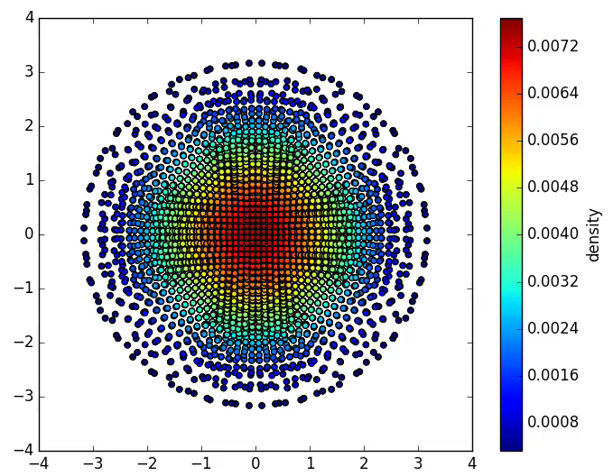
Test problem example: Sedov blast wave
Begins with a spherically symmetric arrangement of particles
A central particle has a large internal energy
Time evolution of the first stage of stellar explosion

Slide 16
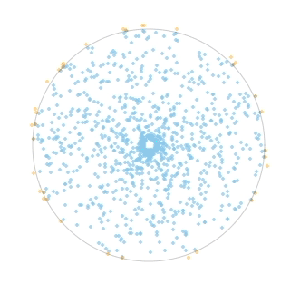
Initial conditions can impact output (Garbage in -> Garbage out)
Because particle positions encode their density, rather than us specifying density outright, setting up the initial density field is not trivial, and it’s crucial to be careful.
https://www.youtube.com/watch?v=ZIL9eMPMdWs

Slide 17
Visualizing output
Smoothed Particle Hydrodynamics

Slide 18
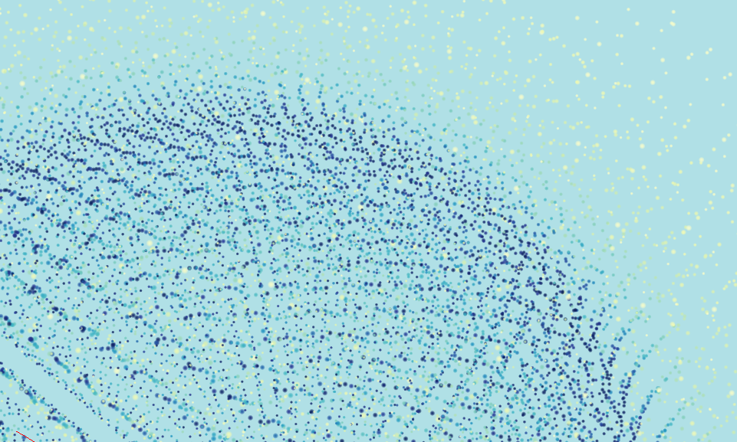
Our visualization tool coupled with our code’s output is built like a flight simulator.
https://www.youtube.com/watch?v=a-8cAYbO2Ds

Slide 19
Future of the code
Code is written for astrophysical simulations:
Stellar evolution
Supernovae
Jets and accretion disks
Galactic evolution
Star and planet formation
Neighbor finding routine in this code: much faster tree structure compared to other software

Slide 20
Thank you
My mentor, Philip A. Pinto
The University of Arizona Space Grant Consortium

